Slide 1
Holy Name OBGYN Residency Bootcamp
Residents as Teachers
Weiping Lin, DO
06/11/2026

Slide 2
Learning Objectives
By the end of this session, participants will be able to:
Explain why residents are essential teachers in OB/GYN clinical education
Apply the One-Minute Preceptor to brief clinical teaching
Practice delivering specific, actionable feedback to learners
Reflect on how residents’ words and actions influence learner professionalism

Slide 3
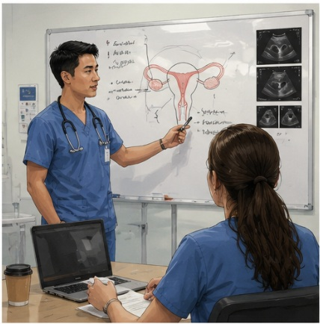

Reflection Exercise
Think about the best resident teacher you worked with.
  What made them effective?
  What made them memorable?
Images created by Lin using ChatGPT (2026)

Slide 4
WHY Residents as Teachers Matters
Residents are essential clerkship educators
  Students learn directly from residents in L&D, OR, clinic, and inpatient settings
Teaching in OB/GYN is high-stakes
  Clinical teaching often occurs during urgent, procedural, and emotionally charged care
Teaching should be taught
  APGO supports structured RaT training in feedback, questioning, procedural teaching, and learner evaluation
APGO/Cullimore 2010; Gaba 2007

Slide 5
WHAT, is Residents as Teachers?
Residents-as-Teachers describes the resident’s role as a near-peer clinical educator who supports learner development during everyday patient care.
This includes:
Orienting learners to the team, setting, and expectations
Teaching in the moment during rounds, clinic, L&D, and OR
Asking clinical reasoning questions to uncover thinking
Teaching procedures through demonstration, coaching, and supervision
Giving feedback that is timely, specific, and actionable
Evaluating learners based on observed clinical performance
Ramani et al., 2016; Cullimore et al., 2010; McKeon et al., 2019

Slide 6
Residents as Teachers?
We will focus on these three because they are common, high-yield, and immediately usable in busy OB/GYN settings:
Give feedback - Feedback giving
Help learners identify what went well and what to improve next
Teach in the moment - One-Minute Preceptor
Use brief clinical encounters to ask, probe, and teach
Model professionalism - Role modeling
Demonstrate how physicians communicate, prioritize, and work in teams
Ramani et al., 2016 — AMEE Guide No. 106

Slide 7
Feedback Giving — Core Concepts
Feedback helps learners improve future performance
Effective feedback is:
Observed — based on what the learner did or said
Specific — names the behavior, not the person
Timely — close to the clinical encounter
Balanced — reinforces strengths and identifies growth areas
Actionable — ends with one concrete next step
Because, Our Students Thrive with Better Advice.

Slide 8
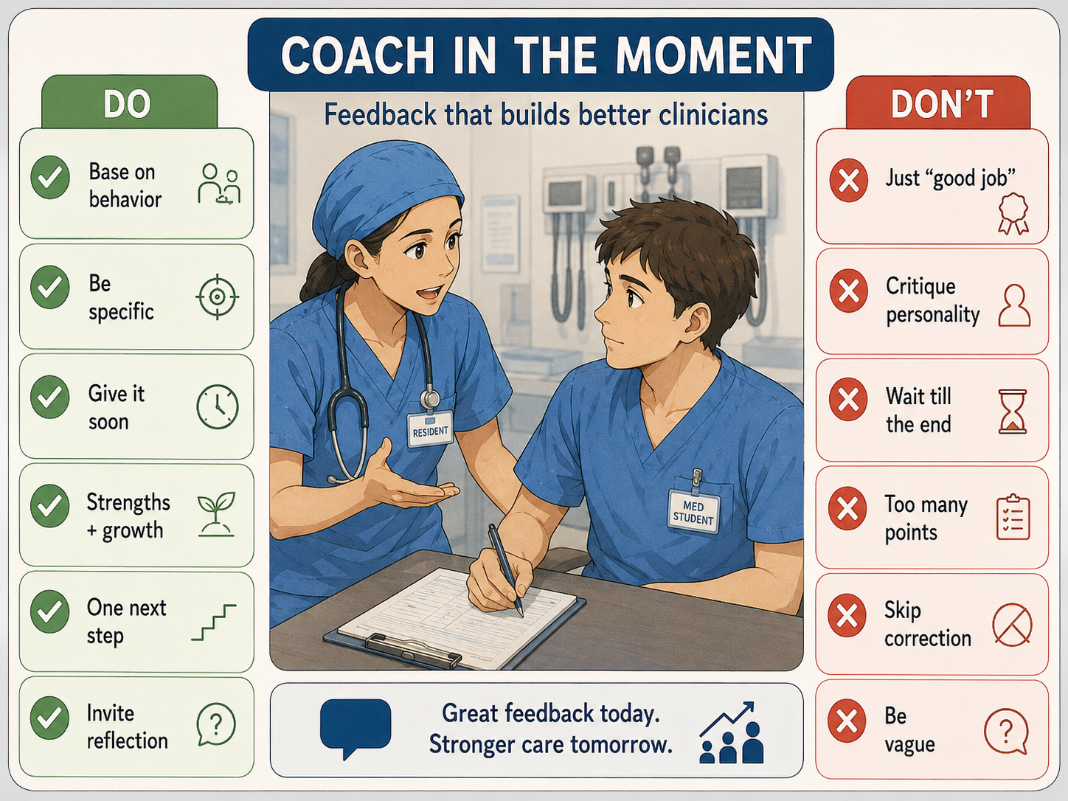
Images created by Lin using ChatGPT (2026)

Slide 9
Two Practical Feedback Tools
Ask-Tell-Ask
Ask: “How do you think that went?”
Tell: “Here is what I observed…”
Ask: “What will you try next time?”
SBI / SBIA
Situation: When/where did it happen?
Behavior: What did the learner do?
Impact: Why did it matter?
Action: What should they try next?

Slide 10
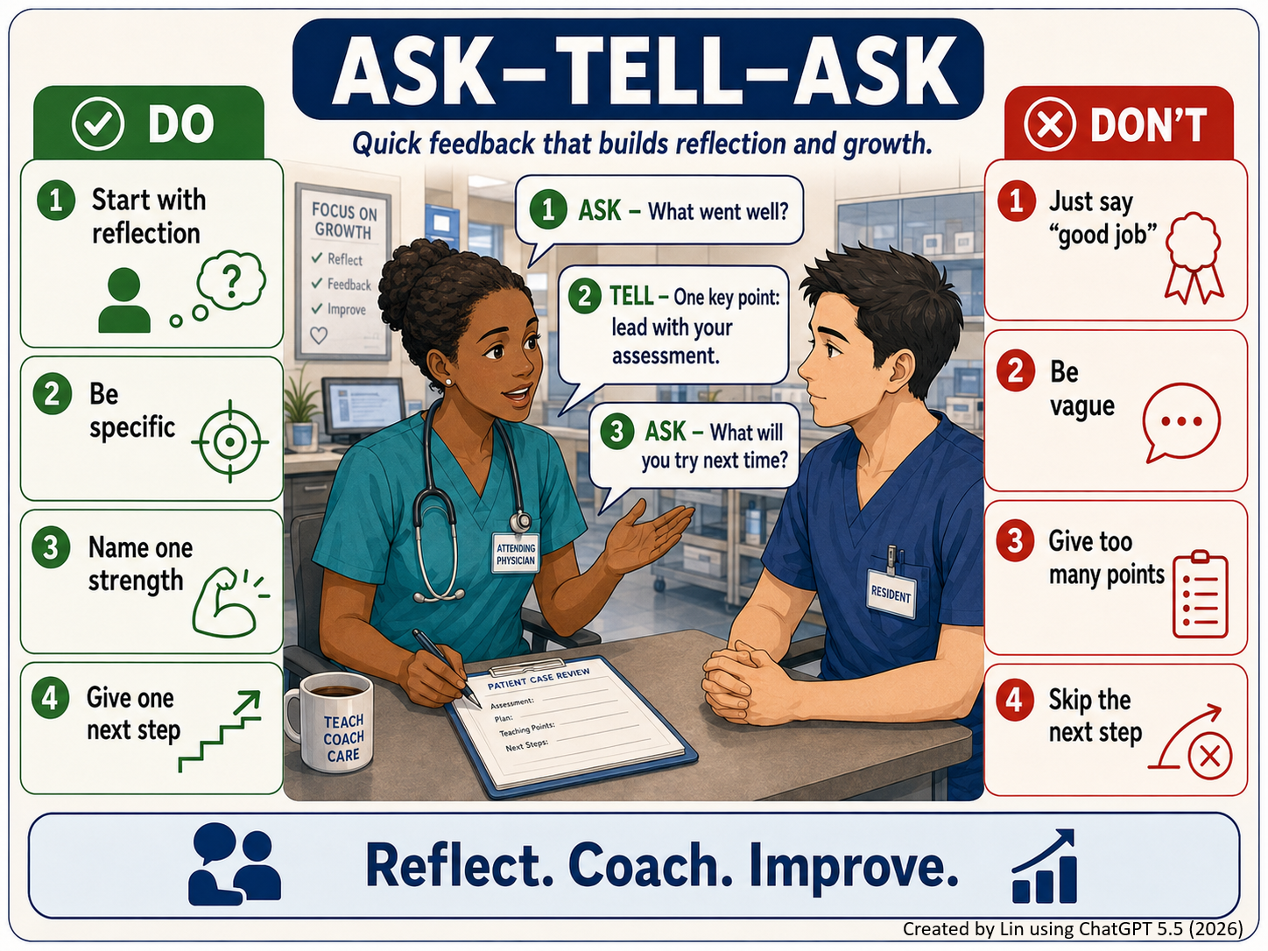

Slide 11
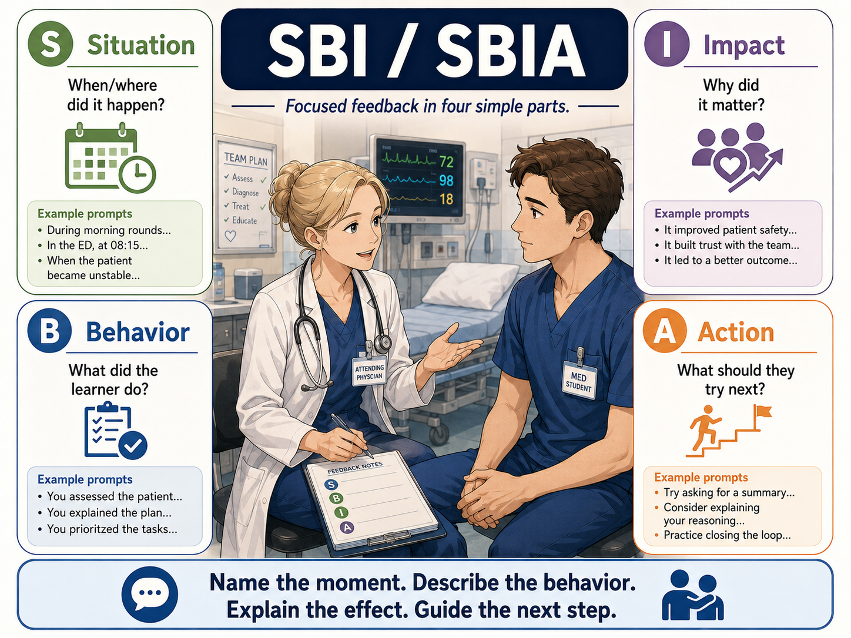
Images created by Lin using ChatGPT (2026)

Slide 12
One-Minute Preceptor (OMP): Teaching in the Moment
One-Minute Preceptor = a 5-step (“microskills”) structure for brief clinical teaching
Use it when a learner presents a patient, asks a question, or proposes a plan.
Commit — “What do you think is going on?”
Probe — “What supports your thinking?”
Teach — Share one general rule
Reinforce — Name what was done well
Refine — Correct, extend, or give one next step
Neher et al. (1992) introduced OMP as a five-step microskills model for efficient clinical teaching. Furney et al. (2001) found that brief OMP training modestly improved resident teaching behaviors, especially getting learner commitment and giving feedback.

Slide 13
OMP Microskill and the “CLEAR” Version
Original OMP microskill | CLEAR version | Explanation
Get a commitment | C — Commit | Ask the learner to take a position before you give the answer.
Probe for supporting evidence | L — Logic | Explore the learner’s reasoning: “What led you there?”
Teach general rules | E — Educate | Give one key point they can use next time.
Reinforce what was done right | A — Affirm | Name the specific behavior or reasoning that worked.
Correct mistakes | R — Refine | Improve or redirect the plan with one concrete next step.

Slide 14
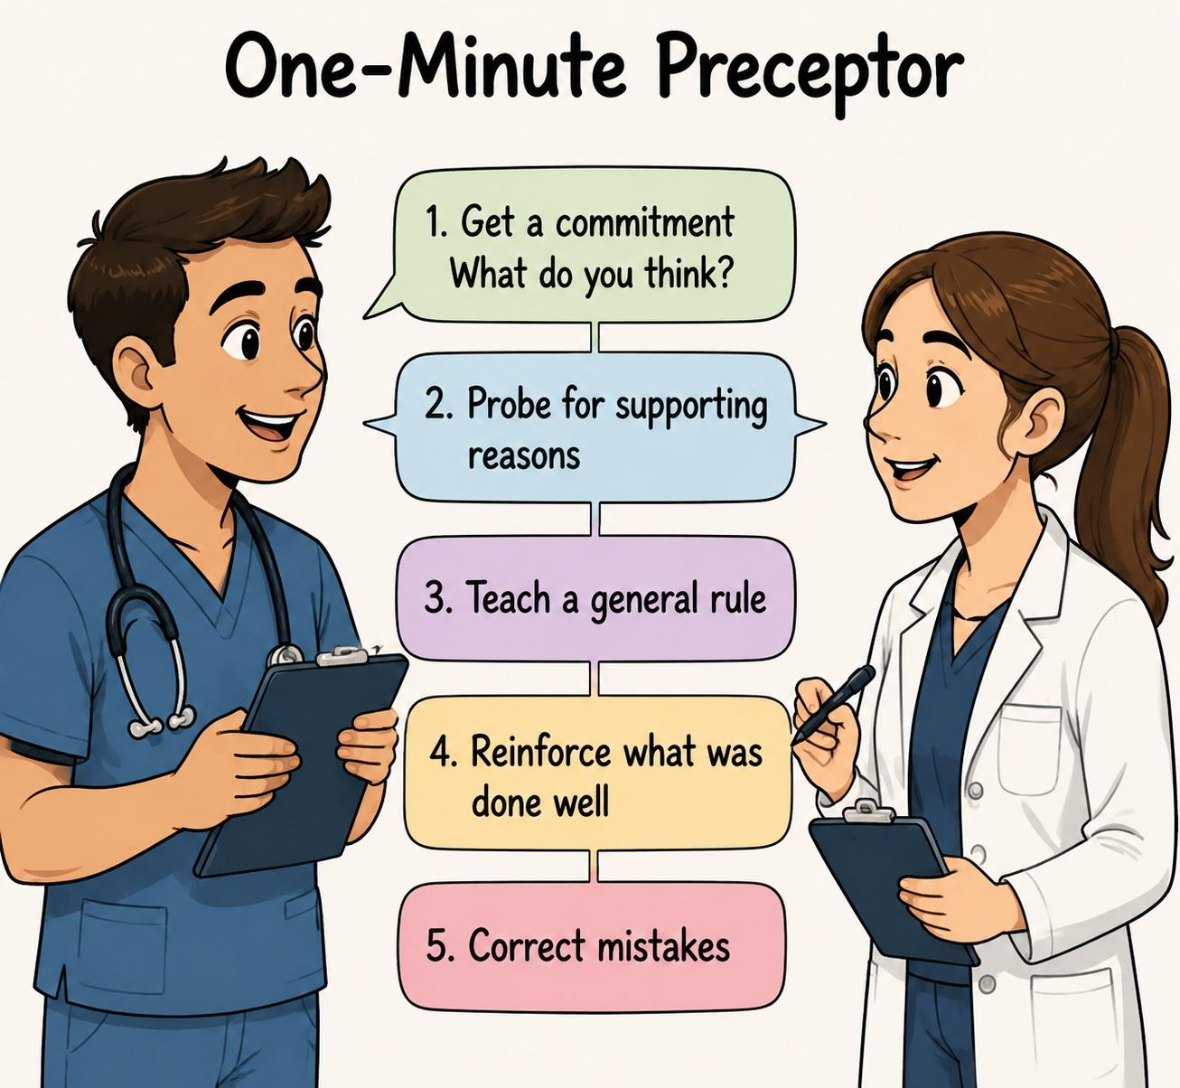
Image created by Lin using ChatGPT (2026)

Slide 15
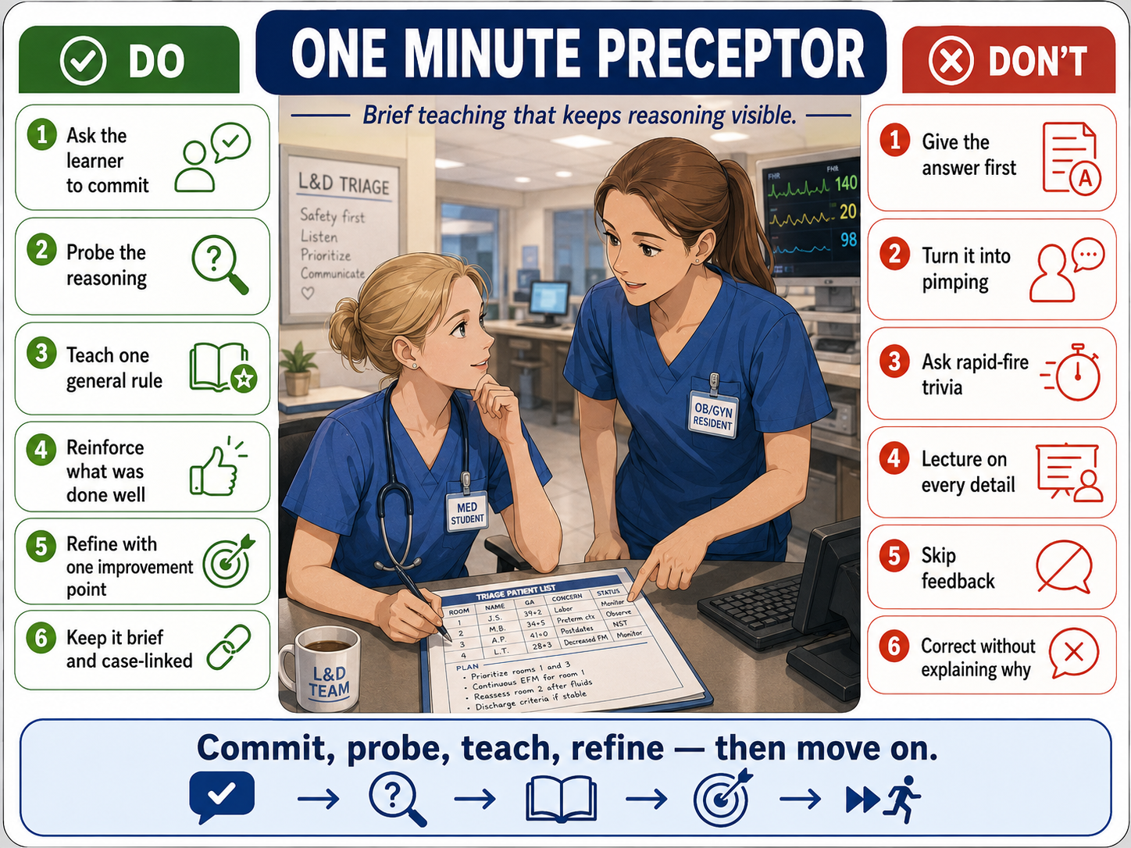
Images created by Lin using ChatGPT (2026)

Slide 16
OMP/Feedback Role-play
Each resident will rotate through three roles:
Teacher — uses the One-Minute Preceptor to teach through the clinical scenario
Learner — responds as the medical student
Observer — watches the teaching, then uses feedback-giving techniques to debrief the teacher
Round structure
Teacher → Learner: clinical OMP teaching
Observer → Teacher: feedback on the teaching
Rotate roles for the next scenario

Slide 17
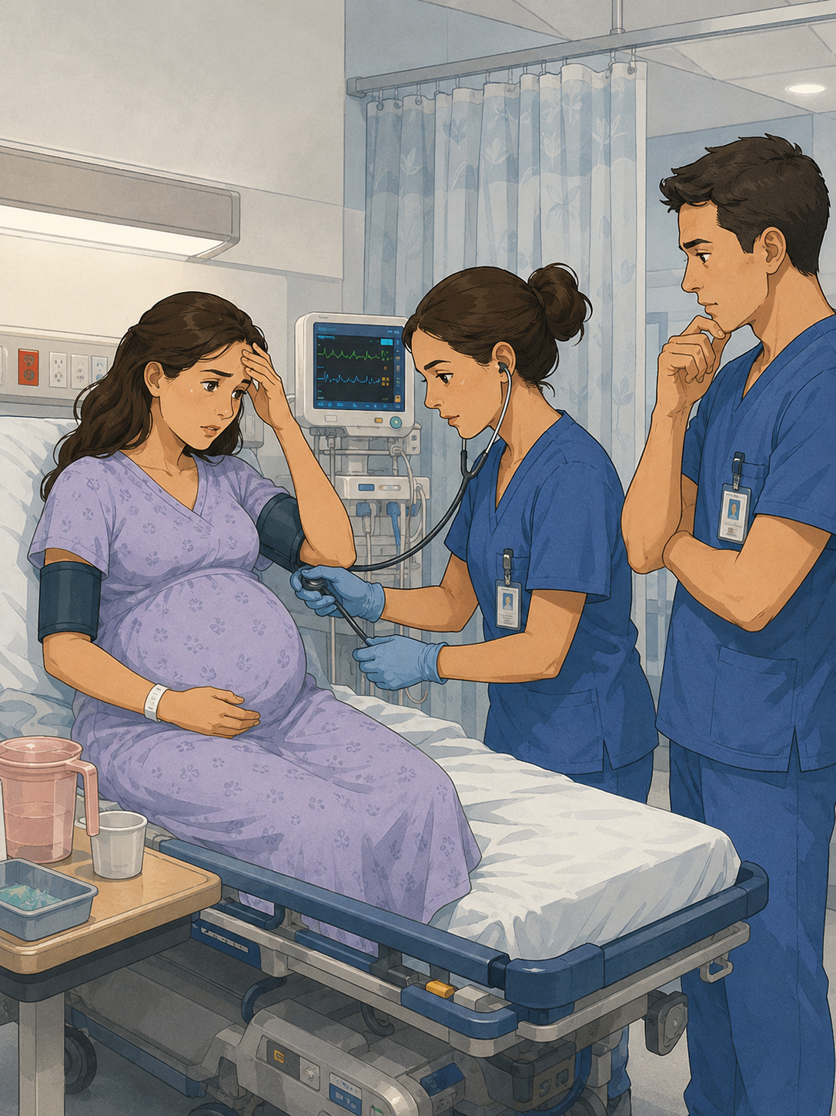
Scenario 1 - L&D Triage
A 32-year-old G1P0 at 36w2d presents to L&D triage with a headache. Her pregnancy has been uncomplicated. She reports normal fetal movement and denies contractions, leakage of fluid, or vaginal bleeding.
Important findings
BP 152/96; repeat 148/94
Mild frontal headache since this morning
No visual symptoms or RUQ pain
Urine dip: trace protein
Possible teaching focus — choose one:
Distinguishing preeclampsia gestational hypertension
Identifying severe features
Prioritizing what changes disposition or urgency
Images created by Lin using ChatGPT (2026)

Slide 18
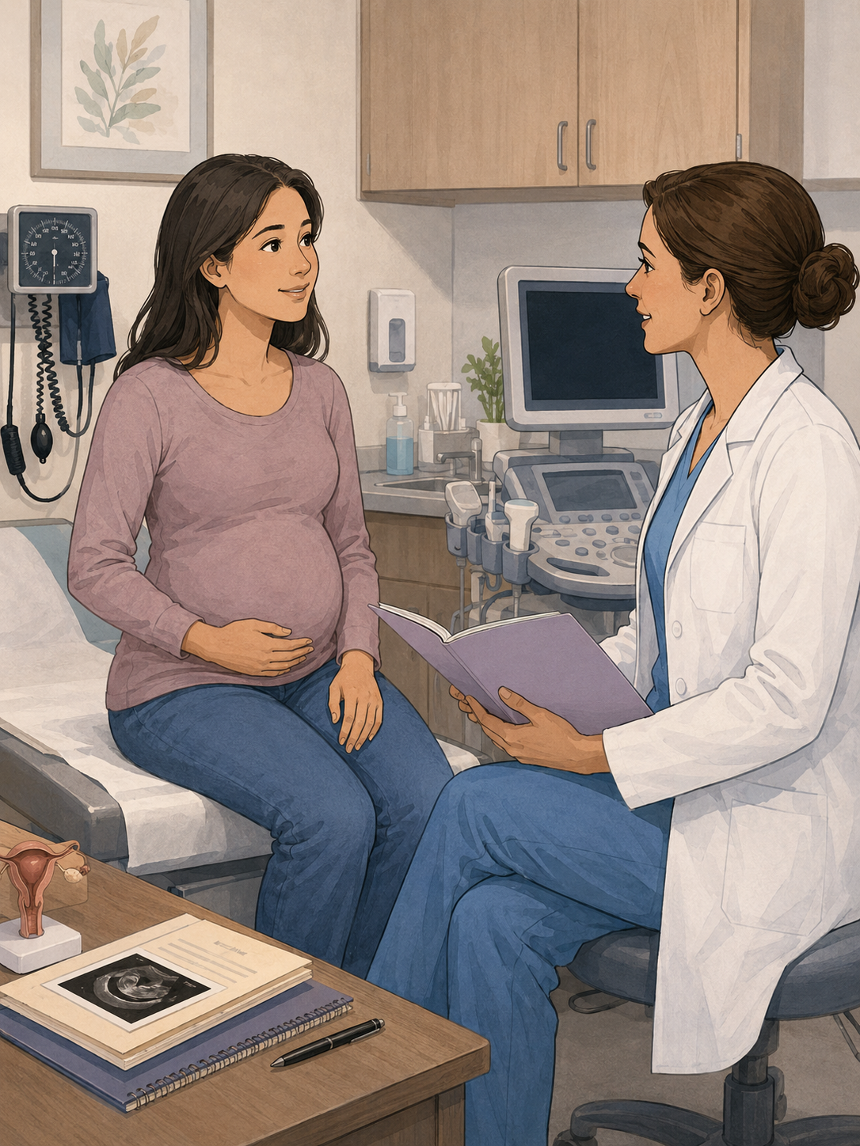
Scenario 2 - First Prenatal Visit
A 28-year-old G2P1001 presents for a new OB visit at approximately 10 weeks by LMP. She has mild nausea but no bleeding or pelvic pain. She had one prior term vaginal delivery and has not yet had an ultrasound this pregnancy.
Important findings
Regular monthly periods before pregnancy
History of chronic hypertension
Not currently on antihypertensive medication
Unsure of last Pap smear
Teaching focus — choose one
Prioritizing dating and pregnancy confirmation
Risk stratification at the first prenatal visit
Connecting medical history to prenatal care planning
Images created by Lin using ChatGPT (2026)

Slide 19
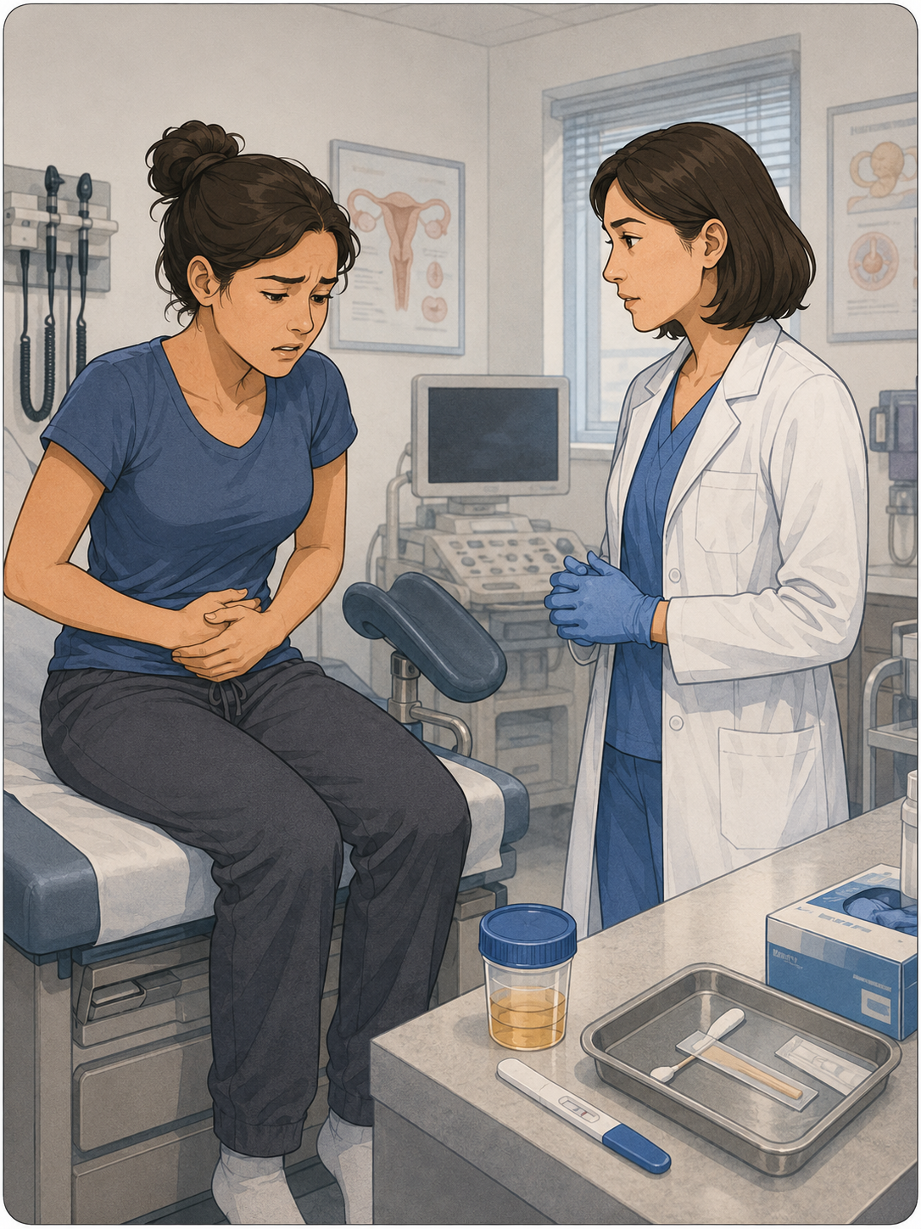
Scenario 3 - GYN Clinic: Pelvic Pain
A 24-year-old G0 presents with two days of lower abdominal pain and vaginal discharge. She has a new partner, no contraception, and her LMP was five weeks ago. She has not taken a pregnancy test.
Important findings
Bilateral lower pelvic pain
Yellow discharge and dyspareunia
Mild dysuria, no flank pain
Temp 99.8°F, HR 96, BP 112/70
Teaching focus — choose one
Avoiding anchoring in pelvic pain
Pregnancy testing as an early branch point
Building a must-not-miss differential before narrowing
Images created by Lin using ChatGPT (2026)

Slide 20
Activity Debrief
Which OMP step felt most natural for your teaching style?
Which step would you need to practice more?
What is one phrase you would actually use?

Slide 21
Role Modeling Professionalism
Learners watch what we normalize
Be intentional
Choose the behavior you want learners to see
Model it clearly
Respect, empathy, teamwork, accountability, calm under stress
Make it explicit
“Notice how I…”
Debrief briefly
“What did you notice?”
“Why did that matter?”
Take-home: Role modeling works best when we make the implicit explicit.
Cruess et al., 2008.

Slide 22
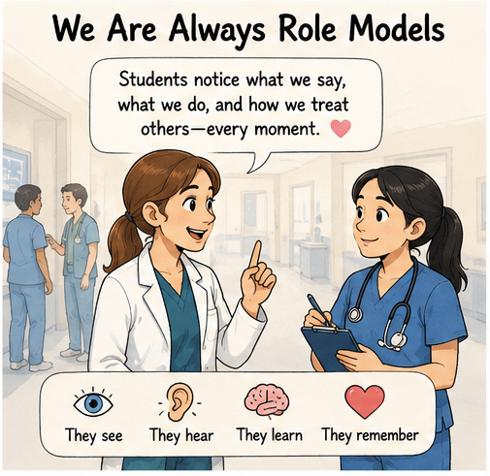
Images created by Lin using ChatGPT (2026)

Slide 23
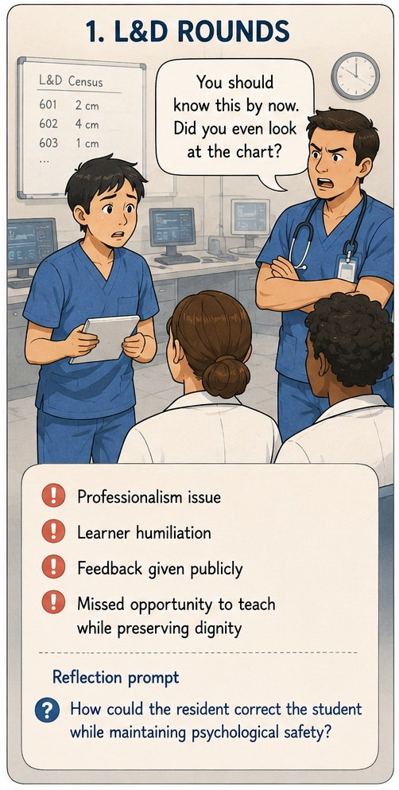
Role-modeling Scenario 1
During busy morning L&D rounds, a medical student presents a patient but misses key details, including overnight blood pressures, symptoms, and pending labs.
The resident is concerned that the incomplete presentation could affect patient care, but responds sharply in front of the team:
“You should know this by now. Did you even look at the chart?”
The student becomes quiet for the rest of rounds, and the missing information still needs to be clarified.
Image created by Lin using ChatGPT (2026)

Slide 24
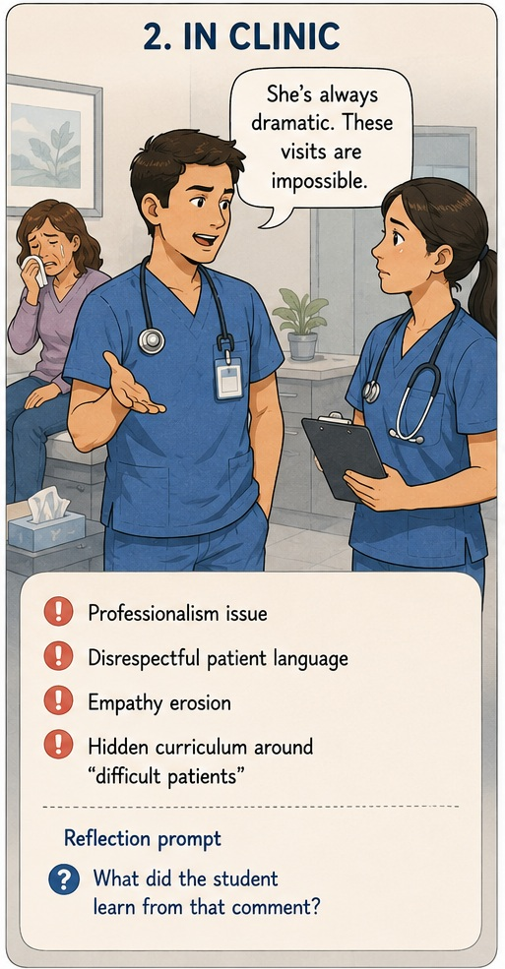
Role-modeling Scenario 2
The clinic is already running behind when a patient with chronic pelvic pain becomes tearful and says, “No one believes me.” She describes years of symptoms and prior visits where she felt dismissed.
The resident appears frustrated as the visit stretches longer. After stepping out of the room, the resident turns to the student and says:
“She’s always dramatic. These visits are impossible.”
The student gives a small, uncomfortable nod and looks down at the chart. The hallway is quiet for a moment before the team moves on to the next patient.
Image created by Lin using ChatGPT (2026)

Slide 25
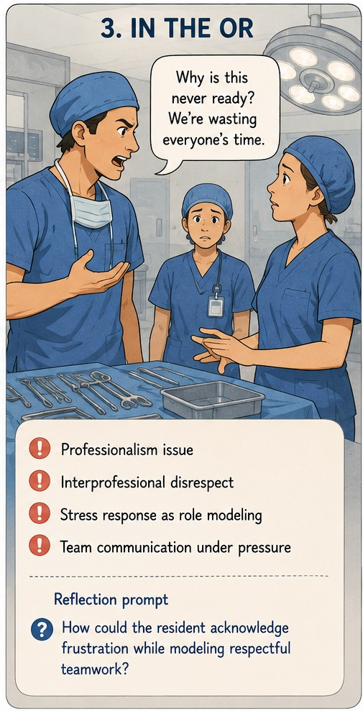
Role-modeling Scenario 3
In the OR, the team is ready to start, but a needed piece of equipment is missing. The attending is waiting, anesthesia is paused, and the circulating nurse is trying to locate the item.
The resident looks visibly frustrated and says sharply:
“Why is this never ready? We’re wasting everyone’s time.”
The student is standing nearby, watching the room get tense. No one responds right away, and the delay continues as the team tries to regroup.
Image created by Lin using ChatGPT (2026)

Slide 26
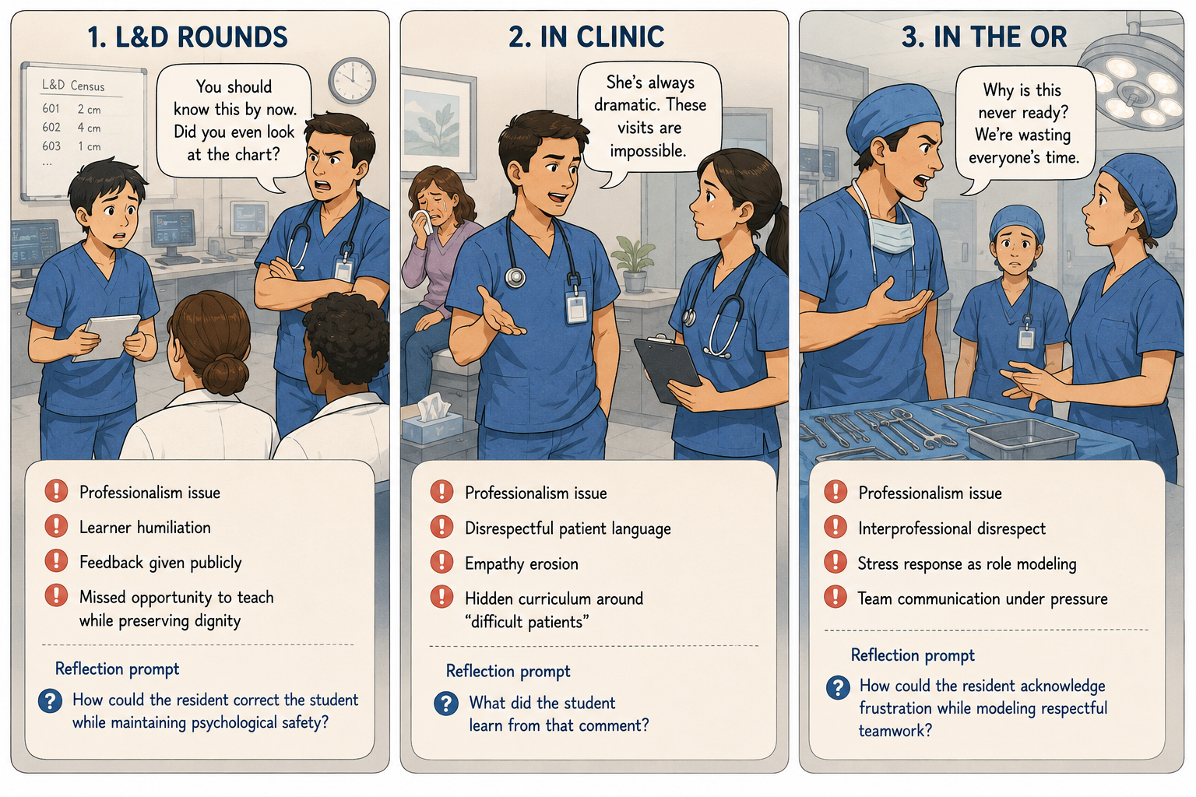

Slide 27
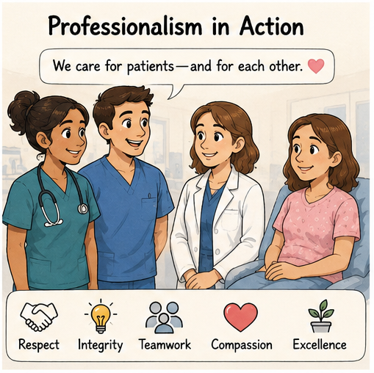
Images created by Lin using ChatGPT (2026)
Created by Lin using Imgflip (2026)

Slide 28
References
Cruess, S. R., Cruess, R. L., & Steinert, Y. (2008). Role modelling—Making the most of a powerful teaching strategy. BMJ, 336(7646), 718–721. https://doi.org/10.1136/bmj.39503.757847.BE
Cullimore, A. J., Dalrymple, J. L., Dugoff, L., Hueppchen, N. A., Casey, P. M., Chuang, A. W., Espey, E. L., Hammoud, M. M., Kaczmarczyk, J. M., Katz, N. T., Nuthalapaty, F. S., & Peskin, E. G. (2010). The obstetrics and gynaecology resident as teacher. Journal of Obstetrics and Gynaecology Canada, 32(12), 1176–1185.
French, J. C., Colbert, C. Y., Pien, L. C., Dannefer, E. F., & Taylor, C. A. (2015). Targeted feedback in the milestones era: Utilization of the Ask-Tell-Ask feedback model to promote reflection and self-assessment. Journal of Surgical Education, 72(6), e274–e279. https://doi.org/10.1016/j.jsurg.2015.05.016
Furney, S. L., Orsini, A. N., Orsetti, K. E., Stern, D. T., Gruppen, L. D., & Irby, D. M. (2001). Teaching the one-minute preceptor: A randomized controlled trial. Journal of General Internal Medicine, 16(9), 620–624. https://doi.org/10.1046/j.1525-1497.2001.016009620.x
Gaba, N. D., Blatt, B., Macri, C. J., & Greenberg, L. (2007). Improving teaching skills in obstetrics and gynecology residents: Evaluation of a residents-as-teachers program. American Journal of Obstetrics and Gynecology, 196(1), 87.e1–87.e7. https://doi.org/10.1016/j.ajog.2006.08.037
Horsburgh, J., & Ippolito, K. (2018). A skill to be worked at: Using social learning theory to explore the process of learning from role models in clinical settings. BMC Medical Education, 18, Article 156. https://doi.org/10.1186/s12909-018-1251-x
McKeon, B. A., Ricciotti, H. A., Sandora, T. J., Ramani, S., Pels, R., Miloslavsky, E. M., Haviland, M. J., & Cho, T. A. (2019). A consensus guideline to support resident-as-teacher programs and enhance the culture of teaching and learning. Journal of Graduate Medical Education, 11(3), 313–318. https://doi.org/10.4300/JGME-D-18-00612.1
Neher, J. O., Gordon, K. C., Meyer, B., & Stevens, N. (1992). A five-step “microskills” model of clinical teaching. Journal of the American Board of Family Practice, 5(4), 419–424.
Ramani, S., Mann, K., Taylor, D., & Thampy, H. (2016). Residents as teachers: Near peer learning in clinical work settings: AMEE Guide No. 106. Medical Teacher, 38(7), 642–655. https://doi.org/10.3109/0142159X.2016.1147540
Silverman, J., Kurtz, S., & Draper, J. (2005). Skills for communicating with patients (2nd ed.). Radcliffe Publishing.

